Slide 1
JAVASCRIPT REGEX
By Davyd Manzhula

Slide 2
AGENDA
RegEx
RegEx Examples
RegEx in JS

Slide 3
Some people, when confronted with a problem, think "I know, I'll use regular expressions." Now they have two problems.
Jamie Zawinski

Slide 4
REGEX BASICS

Slide 5
REGEX BASICS
A regular expression, regex or regexp is a sequence of characters that define a search pattern. Usually this pattern is used by string searching algorithms for "find" or "find and replace" operations on strings, or for input validation.

Slide 6
REGEX BASICS
Depending on the regex processor there are about fourteen metacharacters, characters that may or may not have their literal character meaning, depending on context, or whether they are "escaped", i.e. preceded by an escape sequence, in this case, the backslash \.
Common standards implement both. The usual metacharacters are { } [ ] ( ) ^ $ . | * + ? \ .
The usual characters that become metacharacters when escaped are d s w D S W N.

Slide 7
REGEX BASICS
/pattern/flags
Pattern - the text of the regular expression or, as of ES5, another RegExp object (or literal) (the latter for the two RegExp constructor notations only). Patterns can include special characters so they can match a wider range of values than would a literal string.
Flags - If specified, flags indicates the flags to add, or if an object is supplied for the pattern, the flags value will replace any of that object's flags (and lastIndex will be reset to 0) (as of ES2015). If flags is not specified and a regular expressions object is supplied, that object's flags (and lastIndex value) will be copied over.

Slide 8
g - global match; find all matches rather than stopping after the first match
i - ignore case
m - multiline; treat beginning and end characters (^ and $) as working over multiple lines (i.e., match the beginning or end of each line (delimited by \n or \r), not only the very beginning or end of the whole input string)
s - "dotAll"; allows . to match newlines
u - Unicode; treat pattern as a sequence of Unicode code points
y - sticky; matches only from the index indicated by the lastIndex property of this regular expression in the target string (and does not attempt to match from any later indexes).

Slide 9
REGEX EXAMPLES

Slide 10
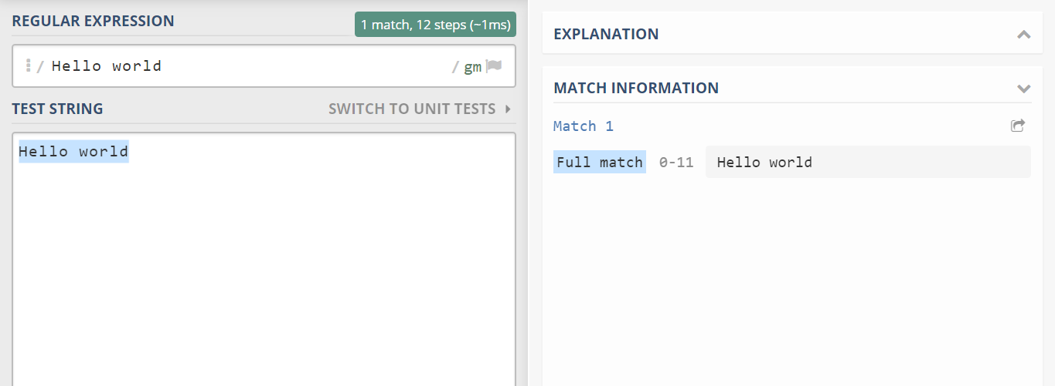
REGEX EXAMPLES

Slide 11
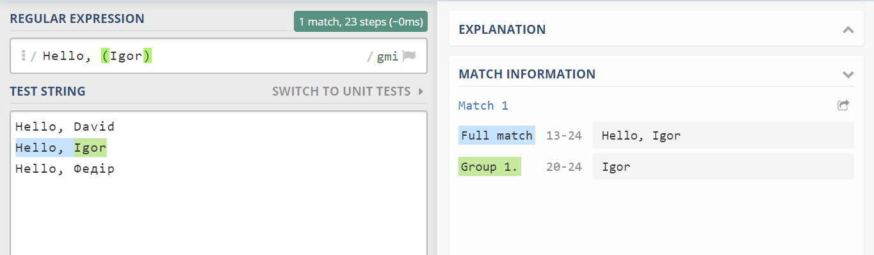
REGEX EXAMPLES

Slide 12
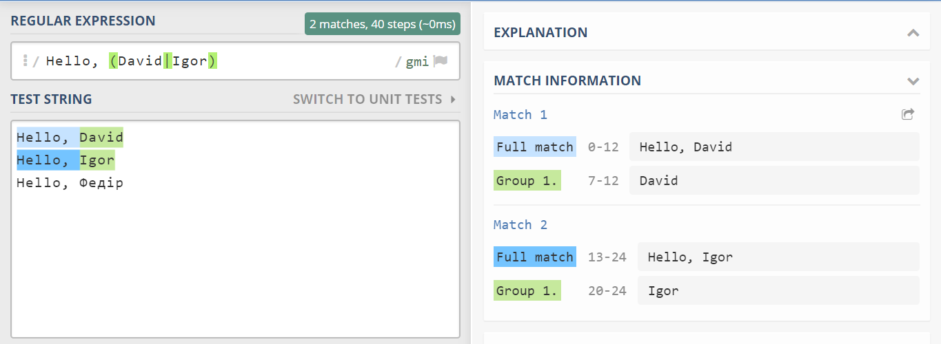
REGEX EXAMPLES

Slide 13
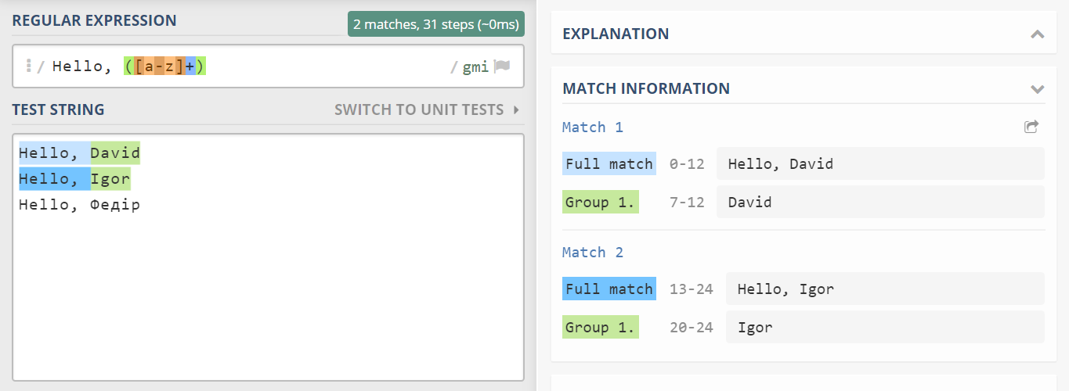
REGEX EXAMPLES

Slide 14
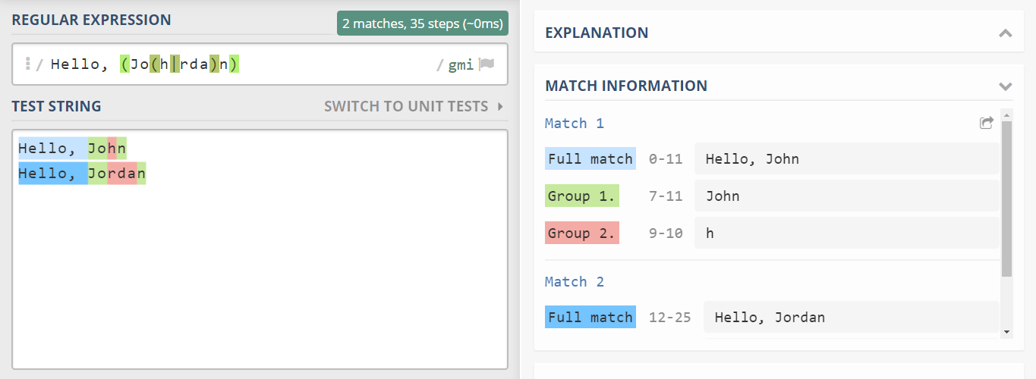
REGEX EXAMPLES

Slide 15
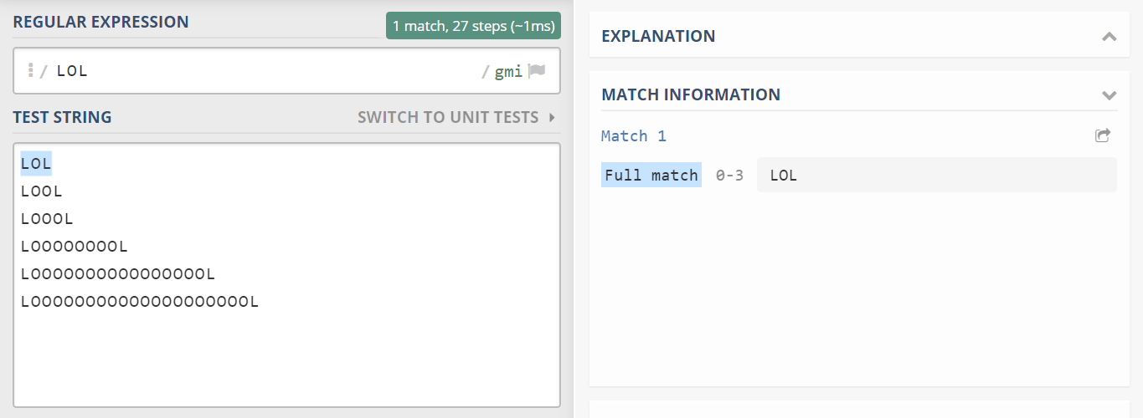
REGEX EXAMPLES

Slide 16
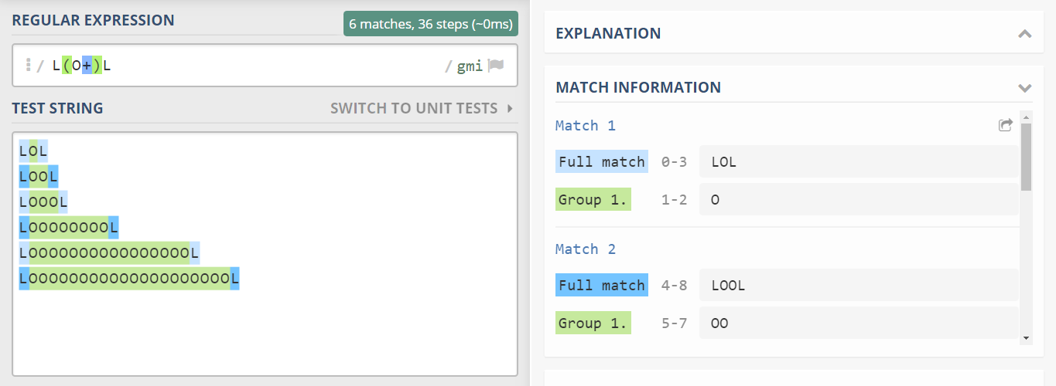
REGEX EXAMPLES

Slide 17
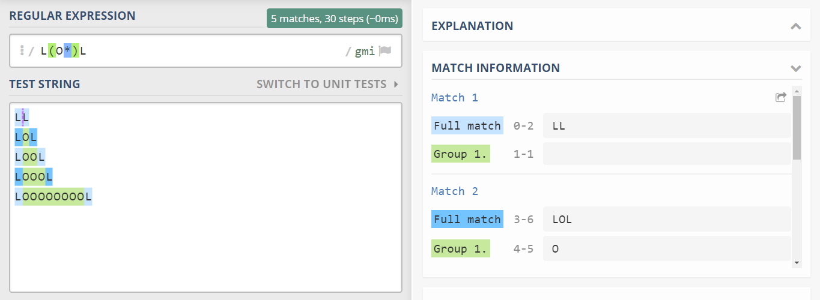
REGEX EXAMPLES

Slide 18
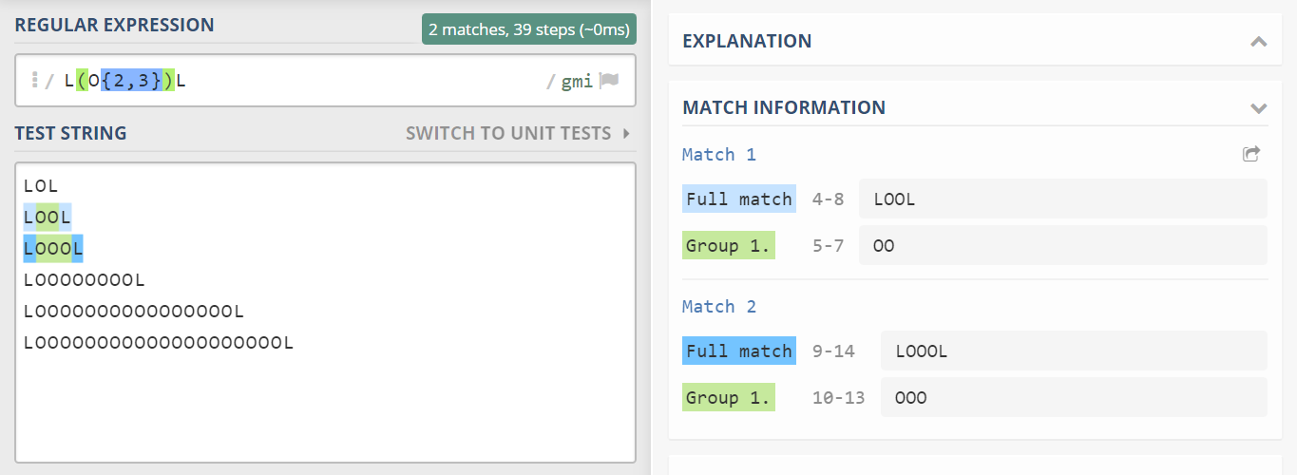
REGEX EXAMPLES

Slide 19
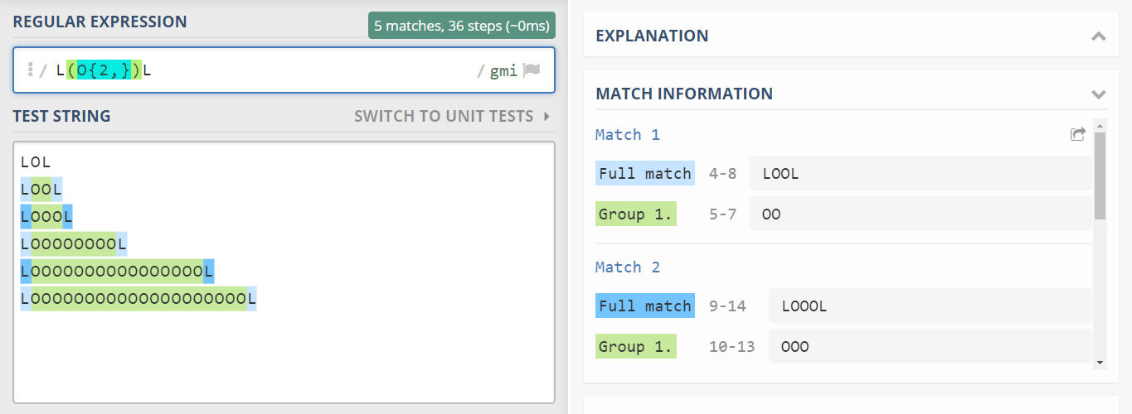
REGEX EXAMPLES

Slide 20
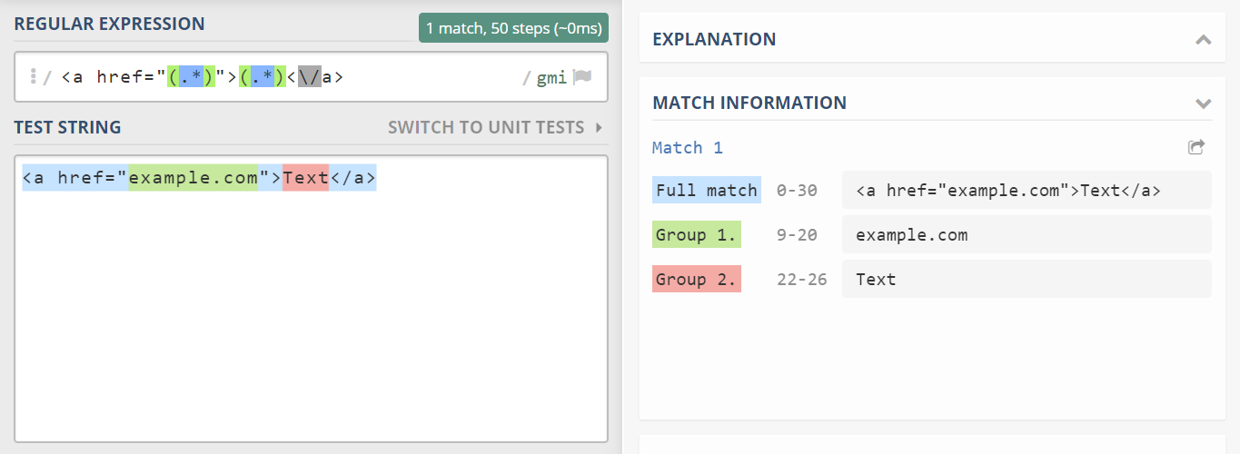
REGEX EXAMPLES

Slide 21
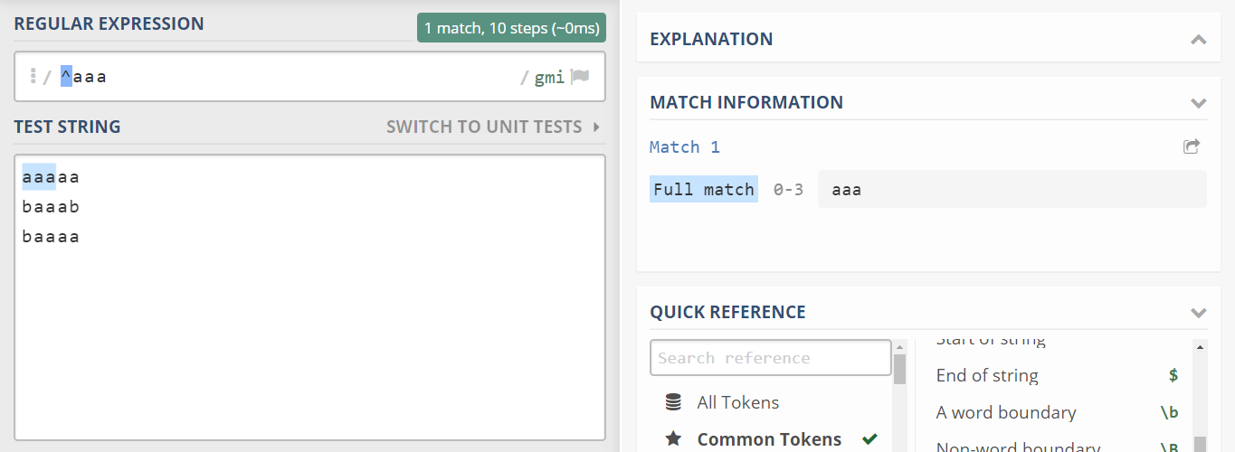
REGEX EXAMPLES

Slide 22
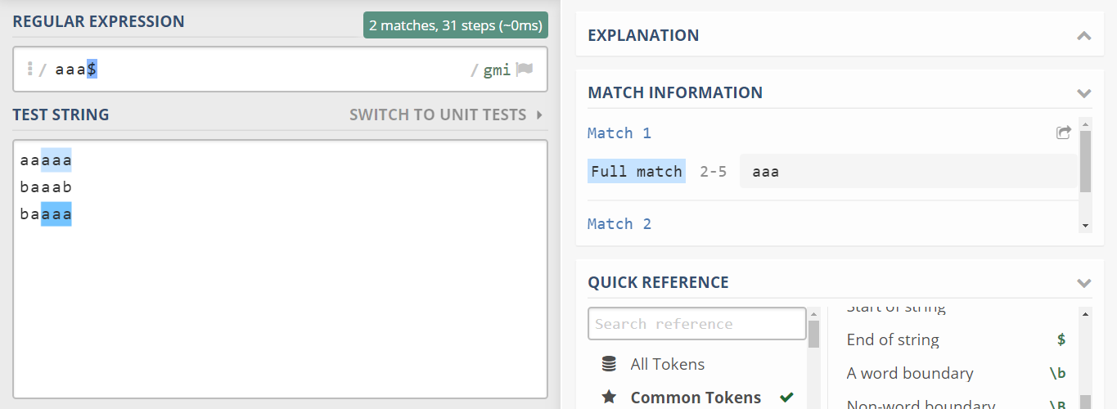
REGEX EXAMPLES

Slide 23
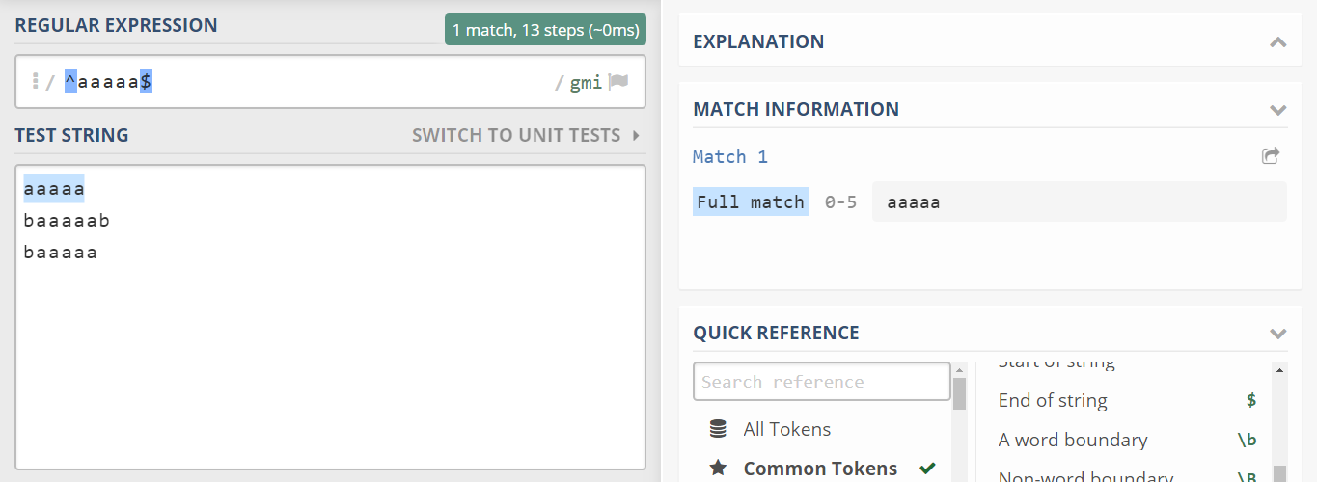
REGEX EXAMPLES

Slide 24
REGEX IN JS

Slide 25
REGEX IN JS
/pattern/flags
new RegExp(pattern[, flags])
RegExp(pattern[, flags])

Slide 26
REGEX IN JS
/([0-9a-f]{16})/ig
new RegExp('([0-9a-f]{16})', 'ig')
new RegExp(/([0-9a-f]{16})/, 'ig')

Slide 27
REGEX IN JS
In general, regular expressions in js are used for:
Search
Match
Replacement

Slide 28
"abcdefghijklmno".match(/.{2}/ig) ["ab", "cd", "ef", "gh", "ij", "kl", "mn"] '<a href="example.com">Text</a>' .match(/<a href="(.*)">(.*)<\/a>/i) [ "<a href="example.com">Text</a>", "example.com", "Text", index: 0, input: "<a href="example.com">Text</a>" ]

Slide 29
`<a href="example.com">Example</a> <a href="google.com">Google</a> <a href="test.com">Test</a> <a href="amazon.com">Amazon</a>` .replace(/<a href="(.*)">(.*)<\/a>/ig, '$1 - $2') example.com – Example google.com – Google test.com – Test amazon.com - Amazon

Slide 30
`<a href="example.com">Example</a> <a href="google.com">Google</a> <a href="test.com">Test</a> <a href="amazon.com">Amazon</a>` .replace(/<a href="(.*)">(.*)<\/a>/ig, '$1 - $2 ($&)') example.com - Example (<a href="example.com">Example</a>) google.com - Google (<a href="google.com">Google</a>) test.com - Test (<a href="test.com">Test</a>) amazon.com - Amazon (<a href="amazon.com">Amazon</a>)

Slide 31
`<a href="example.com">Example</a> <a href="google.com">Google</a> <a href="test.com">Test</a> <a href="amazon.com">Amazon</a>` .replace(/<a href="(.*)">(.*)<\/a>/ig, (match, p1, p2, offset, string) => { return `<a href="${p1}" title="${p2}">${p2}</a>`; }); <a href="example.com" title="Example">Example</a> <a href="google.com" title="Google">Google</a> <a href="test.com" title="Test">Test</a> <a href="amazon.com" title="Amazon">Amazon</a>

Slide 32
USEFUL LINKS
https://developer.mozilla.org/en-US/docs/Web/JavaScript/Reference/Global_Objects/RegExp
https://regex101.com/
https://tproger.ru/articles/regexp-for-beginners/

